Slide 1

Academic Year 2025 - 26 MINI PROJECT Phase - 2 Review
PROJECT TITLE
Academic Learning Effectiveness Platform
SkillBridge
VIDHYA S
7376231MZ155

Slide 2
Academic Year 2025 - 26 MINI PROJECT Phase - 2 Review
1 . Aim and Objective of the project
2. Literature Survey
3. Technical Stack
4. Proposed Methodology
5. Design
6. Database Schema
7. Reference

Slide 3
AIM & OBJECTIVES OF THE PROJECT (Problem Statement)
AIM :
Local sellers struggle to reach nearby customers due to the lack of accessible digital platforms.
Customers find it difficult to discover and shop from local businesses efficiently.
Existing online marketplaces primarily focus on large vendors, resulting in low visibility for small community sellers.
There is a need for a simple and user-friendly web application that connects local sellers and customers, enabling easy product discovery, ordering, and communication within the community.
OBJECTIVE :
To develop a secure and user-friendly web application that connects local sellers, buyers, and delivery partners within a community.
The system aims to enable easy product listing, browsing, ordering, and delivery management through a role-based digital marketplace.

Slide 4
LITERATURE SURVEY
Sl.No. | Journal Paper Title with Author | Works carried out ( with details of Methods/ Materials/ Software/ Algorithms / fabrication / techniques/ components used ) | Information gathered relevant to your project
1 | Peri Hartman; Jeffrey P. Bezos; Shel Kapha Patent Id : 5,960,411 | Frontend - HTML, CSS, JavaScript Backend - Java / PHP / Python (Server-side scripting) Database - MongoDB ,Session Handling - Cookies / Session Tokens Security - SSL/TLS encryption | React.js (frontend), Node.js & Express.js (backend), MongoDB Atlas (database), JWT authentication, and Firebase services
2 | Richa Arora, Priyanshu Raj, Srinivas Deshpande, Ananda Matthur, Roshan Nair, Sasikanth Lenka. Praveen R S Patent Id: 11907094 | Backend Processing - Java/ Python/Node.js Data Streaming - Apache Kafka / Streaming APIs Database - SQL Deployment - Cloud Infrastructure | Studied real-time data monitoring techniques and anomaly detection methods. Understood how current metrics are compared with historical benchmarks using thresholds. Learned about automated detection systems that improve system reliability and reduce manual monitoring.

Slide 5
CHOICE OF COMPONENTS / MODULES / METHODS / TECHNIQUES EQUIPMENT USED FOR PROJECT DEVELOPMENT
COMPONENTS:
Frontend Technologies Used :
Framework: HTML, CSS, React.js
Programming Languages: JavaScript
Backend Technologies Used
Backend Platform: Node.js, Express.js
Database: MongoDB Atlas
Authentication: JWT (JSON Web Token)
Notifications: Firebase Cloud Messaging
Tools: Figma, GitHub, Postman, VS Code

Slide 6
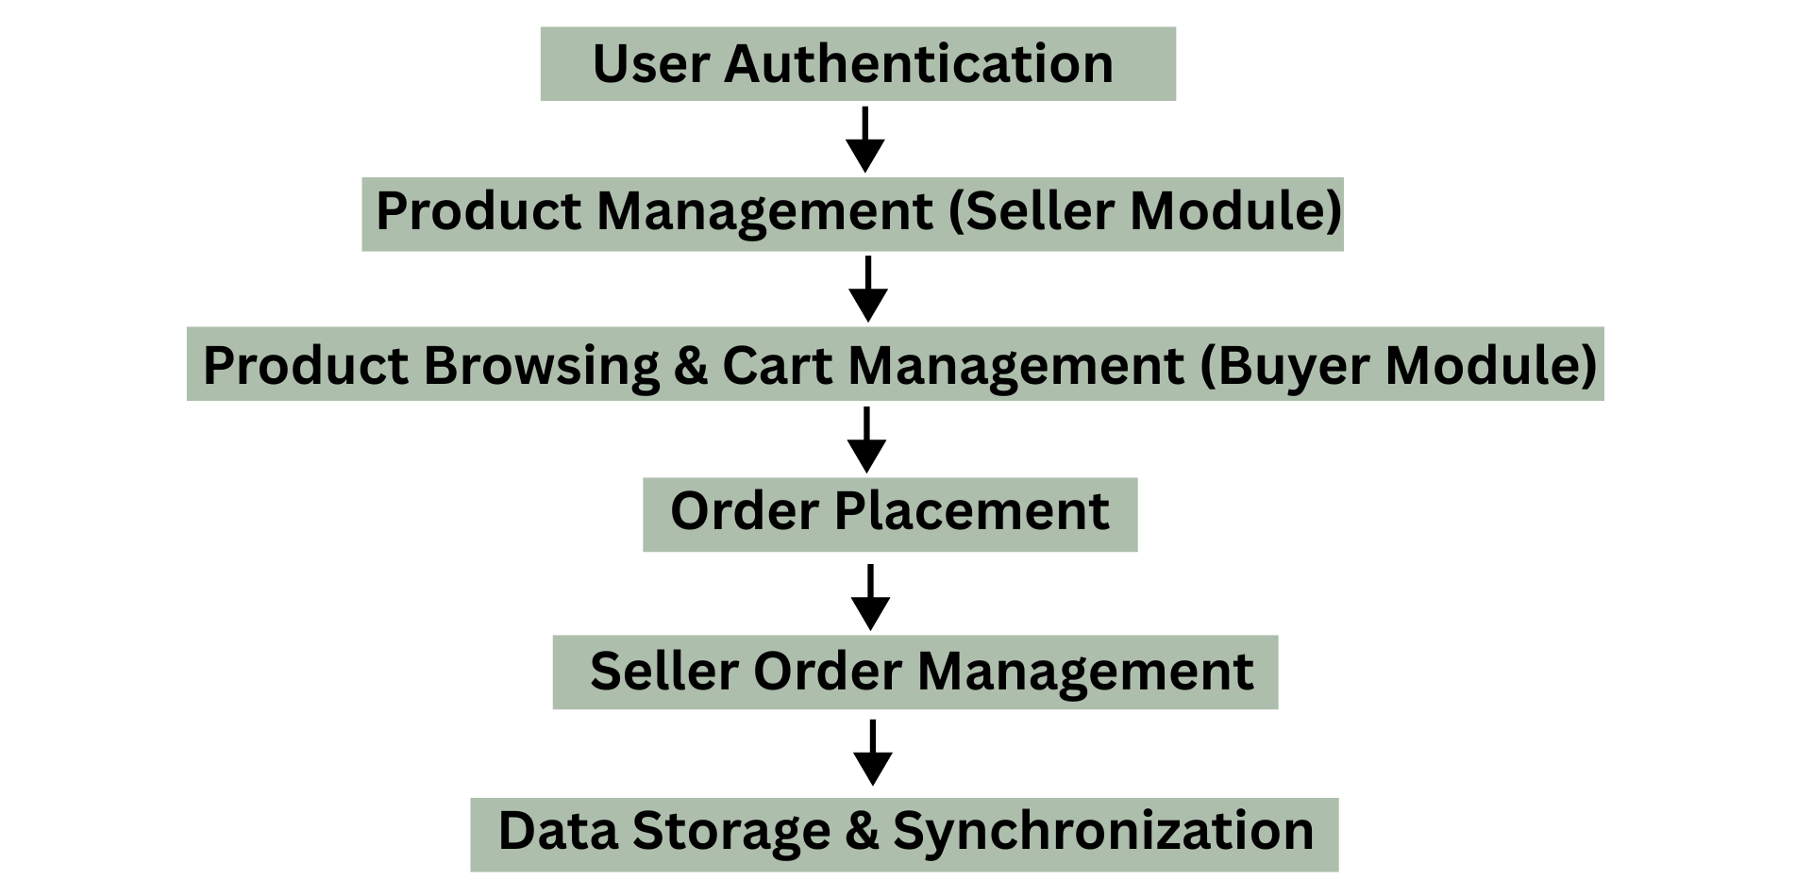
PROPOSED METHODOLOGY

Slide 7
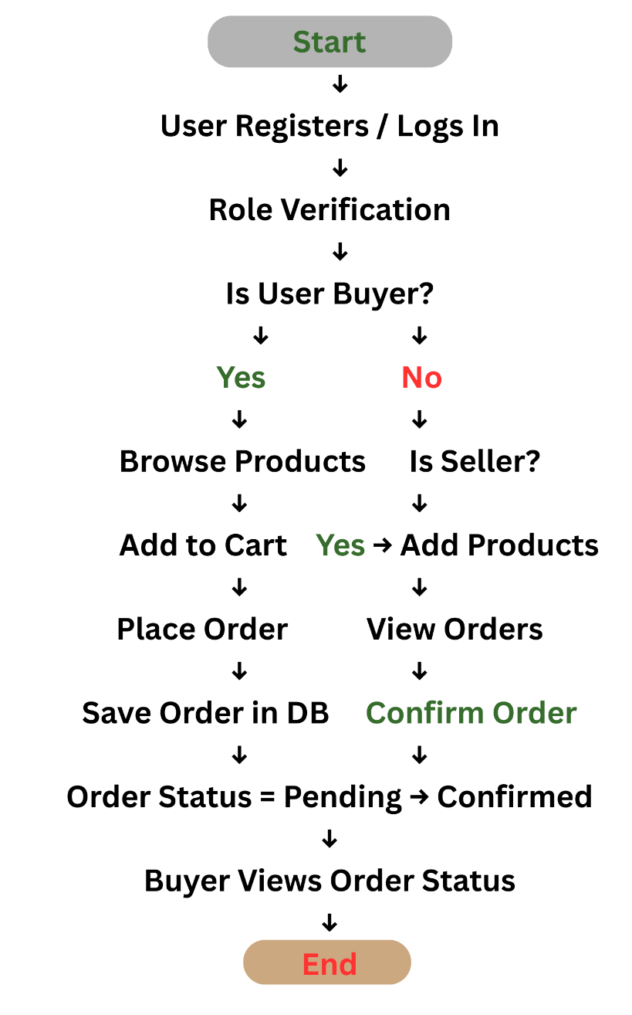
PROPOSED METHODOLOGY

Slide 8
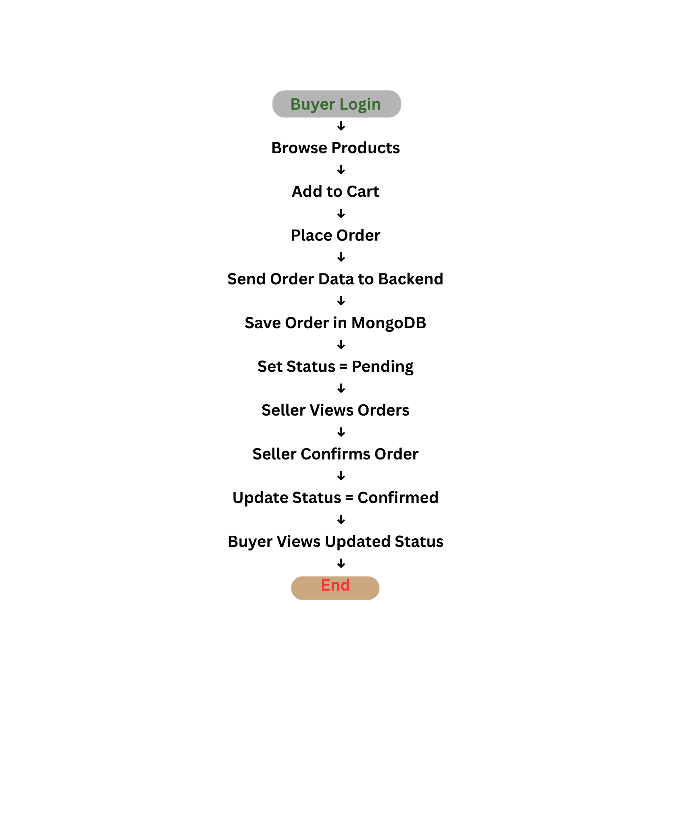
PROPOSED METHODOLOGY

Slide 9
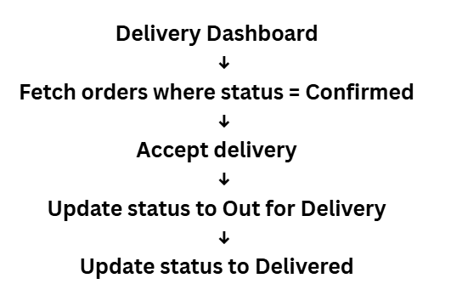
PROPOSED METHODOLOGY

Slide 10
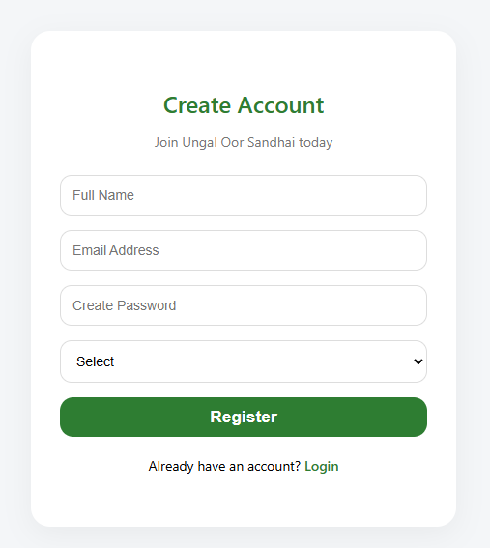
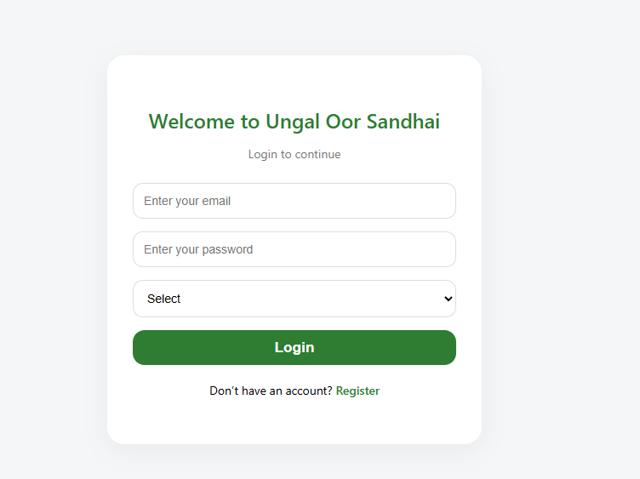
DESIGN(S) (HARDWARE / SOFTWARE ARCHITECTURE)

Slide 11
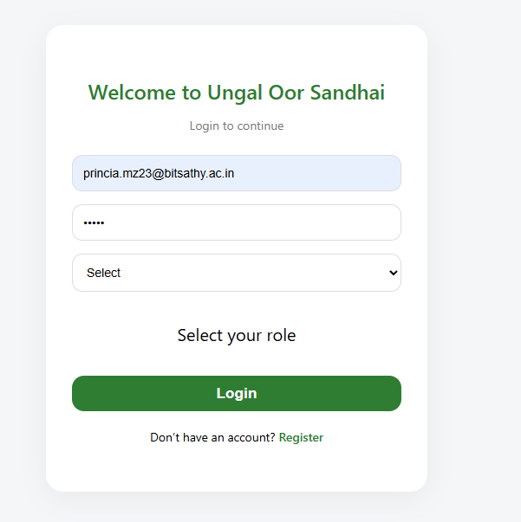
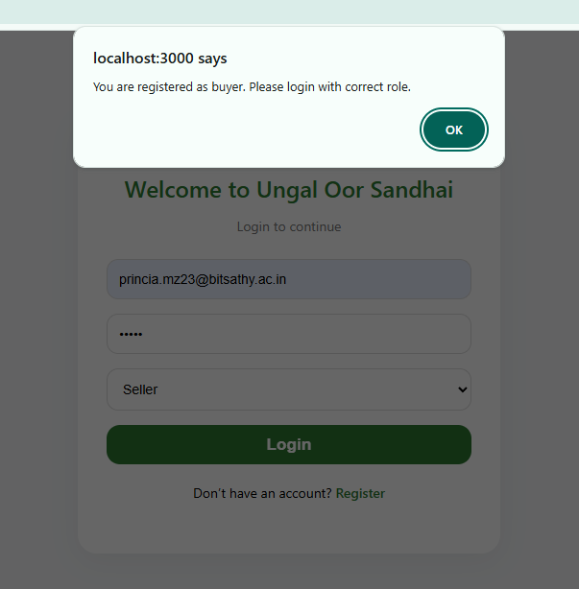
DESIGN(S) (HARDWARE / SOFTWARE ARCHITECTURE)

Slide 12
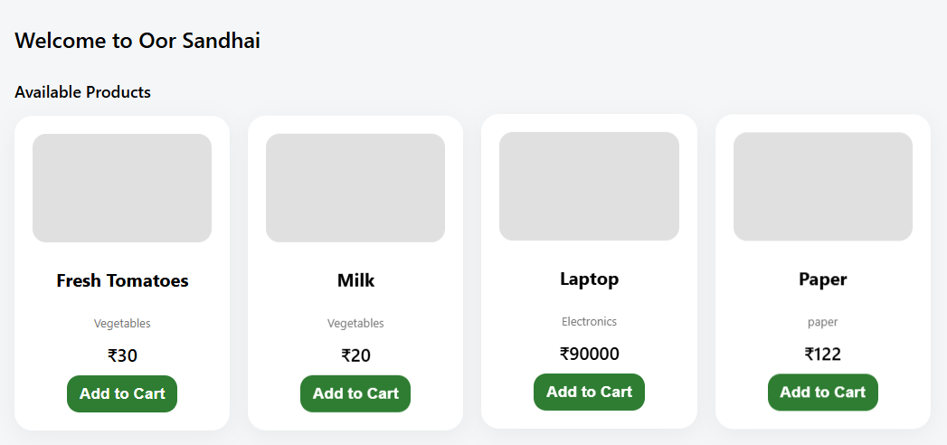
DESIGN(S) (HARDWARE / SOFTWARE ARCHITECTURE)

Slide 13
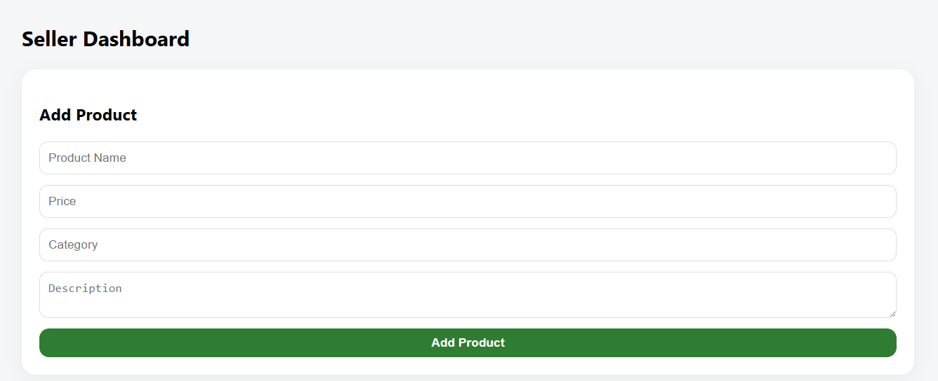
DESIGN(S) (HARDWARE / SOFTWARE ARCHITECTURE)

Slide 14
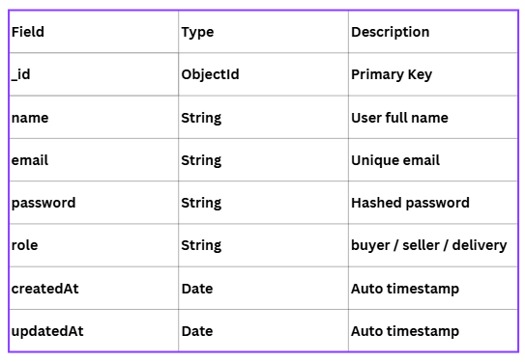
DATABASE SCHEMA
Users :

Slide 15
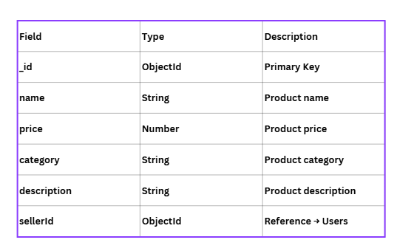
DATABASE SCHEMA
Products :

Slide 16
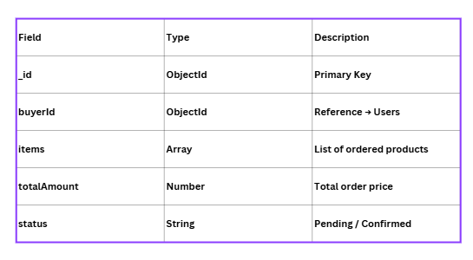
DATABASE SCHEMA
Orders :

Slide 17
REFERENCES ( Journal Papers/ Books / Patent)
Journal
Design and Implementation of a Hyperlocal E-Commerce Marketplace – S. Sharma, R. Verma (2021)
Books
E-Commerce Analytics: Predict, Improve, and Grow Your Business – Judah Phillips
Patent
Peri Hartman; Jeffrey P.Bezos; Shel Kapha. Patent Id: 5,960,411

Slide 18
Academic Year 2025 - 26 MINI PROJECT Phase - 2 Review
PROJECT TITLE
LOCAL COMMUNITY MARKET - WEB APP
Oor Sandhai
PRINCIA I
7376231MZ134
GitHub: https://github.com/princiagit/Oor_Sandhai

Slide 19
Academic Year 2025 - 26 MINI PROJECT Phase - 2 Review
1 . Aim and Objective of the project
2. Literature Survey
3. Technical Stack
4. Proposed Methodology
5. Design
6. Database Schema
7. Reference

Slide 20
AIM & OBJECTIVES OF THE PROJECT (Problem Statement)
AIM :
Local sellers struggle to reach nearby customers due to the lack of accessible digital platforms.
Customers find it difficult to discover and shop from local businesses efficiently.
Existing online marketplaces primarily focus on large vendors, resulting in low visibility for small community sellers.
There is a need for a simple and user-friendly web application that connects local sellers and customers, enabling easy product discovery, ordering, and communication within the community.
OBJECTIVE :
To develop a secure and user-friendly web application that connects local sellers, buyers, and delivery partners within a community.
The system aims to enable easy product listing, browsing, ordering, and delivery management through a role-based digital marketplace.

Slide 21
LITERATURE SURVEY
Sl.No. | Journal Paper Title with Author | Works carried out ( with details of Methods/ Materials/ Software/ Algorithms / fabrication / techniques/ components used ) | Information gathered relevant to your project
1 | Peri Hartman; Jeffrey P. Bezos; Shel Kapha Patent Id : 5,960,411 | Frontend - HTML, CSS, JavaScript Backend - Java / PHP / Python (Server-side scripting) Database - MongoDB ,Session Handling - Cookies / Session Tokens Security - SSL/TLS encryption | React.js (frontend), Node.js & Express.js (backend), MongoDB Atlas (database), JWT authentication, and Firebase services
2 | Richa Arora, Priyanshu Raj, Srinivas Deshpande, Ananda Matthur, Roshan Nair, Sasikanth Lenka. Praveen R S Patent Id: 11907094 | Backend Processing - Java/ Python/Node.js Data Streaming - Apache Kafka / Streaming APIs Database - SQL Deployment - Cloud Infrastructure | Studied real-time data monitoring techniques and anomaly detection methods. Understood how current metrics are compared with historical benchmarks using thresholds. Learned about automated detection systems that improve system reliability and reduce manual monitoring.

Slide 22
CHOICE OF COMPONENTS / MODULES / METHODS / TECHNIQUES EQUIPMENT USED FOR PROJECT DEVELOPMENT
COMPONENTS:
Frontend Technologies Used :
Framework: HTML, CSS, React.js
Programming Languages: JavaScript
Backend Technologies Used
Backend Platform: Node.js, Express.js
Database: MongoDB Atlas
Authentication: JWT (JSON Web Token)
Notifications: Firebase Cloud Messaging
Tools: Figma, GitHub, Postman, VS Code

Slide 23
PROPOSED METHODOLOGY

Slide 24
PROPOSED METHODOLOGY

Slide 25
PROPOSED METHODOLOGY

Slide 26
PROPOSED METHODOLOGY

Slide 27
DESIGN(S) (HARDWARE / SOFTWARE ARCHITECTURE)

Slide 28
DESIGN(S) (HARDWARE / SOFTWARE ARCHITECTURE)

Slide 29
DESIGN(S) (HARDWARE / SOFTWARE ARCHITECTURE)

Slide 30
DESIGN(S) (HARDWARE / SOFTWARE ARCHITECTURE)

Slide 31
DATABASE SCHEMA
Users :

Slide 32
DATABASE SCHEMA
Products :

Slide 33
DATABASE SCHEMA
Orders :

Slide 34
REFERENCES ( Journal Papers/ Books / Patent)
Journal
Design and Implementation of a Hyperlocal E-Commerce Marketplace – S. Sharma, R. Verma (2021)
Books
E-Commerce Analytics: Predict, Improve, and Grow Your Business – Judah Phillips
Patent
Peri Hartman; Jeffrey P.Bezos; Shel Kapha. Patent Id: 5,960,411

Slide 35
AIM & OBJECTIVES OF THE PROJECT (Problem Statement)
AIM :
The aim of this research is to design and develop an intelligent chatbot for admission and
college enquiry.
OBJECTIVE :
● Understanding user needs and preferences
● Improving natural language processing (NLP) capabilities
● Developing personalized chatbot interactions
● Enhancing chatbot usability and user experience
● Ensuring chatbot safety and security
● Target audience
● Effectiveness

Slide 36
LITERATURE SURVEY
Sl.No. | Journal Paper Title with Author | Works carried out ( with details of Methods/ Materials/ Software/ Algorithms / fabrication / techniques/ components used ) | Information gathered relevant to your project
1 | Authors: Safwa Samad, Mohammed Hashim O A, Anjali N B, Adwaith Nidheesh, Dr. L. C. Manikandan Paper Id : IJRASET68413 | Chatbot built using Dialogflow, FastAPI, MySQL, JWT, NLP techniques. | Information gathered relevant to my project: Collected FAQs on admissions, studied NLP techniques, tools (Flask, NLTK).
2 | Zaira Zaid, Sachin Jain, Blessy Thankachan. (2023). Research Paper Based on Artificial Intelligence Chatbot. | Node.js, HTML, CSS, JavaScript, NPM, conversational search, admission queries. | NLP, and conversational search for admissions.
3
4
5

Slide 37
SCOPE OF THE PROJECT
The chatbot will assist prospective students with admission-related queries such as requirements, application procedures, deadlines, and course details.
It will provide information about fee structures, financial aid, and scholarships.
Future scope includes real-time application tracking, integration with databases or student systems, and multilingual support.
It will be developed as a web-based application for easy access and usability.
The chatbot aims to reduce the workload of admission staff by automating responses to frequently asked questions.
There is no specific chatbot designed for our college with our college’s data in it and Mostly paid services with high cost

Slide 38
NEED FOR THE CURRENT STUDY
GROWING USE OF CHATBOTS:
The increasing integration of chatbots across sectors (e.g.,
healthcare, education, customer service) highlights the need for
more intelligent and adaptable systems.
LIMITATIONS:
Inadequate personalization.
Poor contextual understanding.
Limited adaptability to individual user needs.
NLP:
Despite rapid progress in Natural Language Processing
(NLP), many systems fail to fully leverage these capabilities to
enhance interaction quality.
There is no specific chatbot designed for our college with our college’s data in it and Mostly paid services with high cost

Slide 39
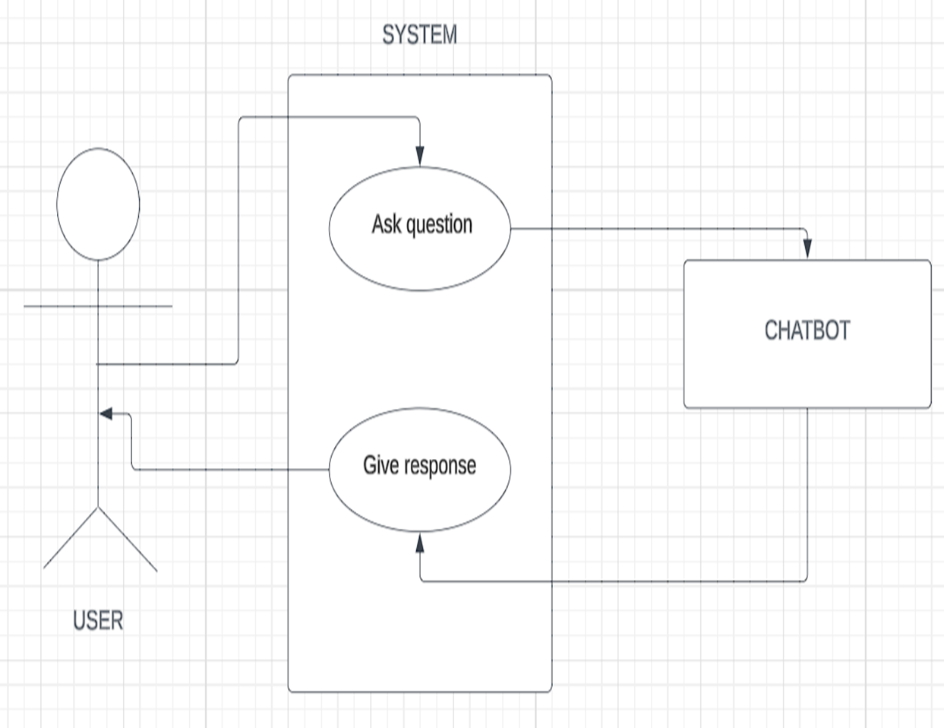
PROPOSED METHODOLOGY ( Flow Chart)

Slide 40
CHOICE OF COMPONENTS / MODULES / METHODS / TECHNIQUES EQUIPMENT USED FOR PROJECT DEVELOPMENT
COMPONENTS:
User Interface Component - HTML structure + CSS styling
Frontend: html , css
Backend: Python
Web framework: Flask (python)
Database Module: Intents.json file (stores tags, patterns, responses)
METHODS:
Natural Language Processing (NLP): Tokenization, Lemmatization, Stopword removal
NLTK → A library for Natural Language Processing (NLP). For tokenization and lemmatization.
Search & Filter Module → Text-based filtering (title, content, tags) , Tag-based filtering (clicking a tag to filter).
Flask → Handles backend web server logic.

Slide 41
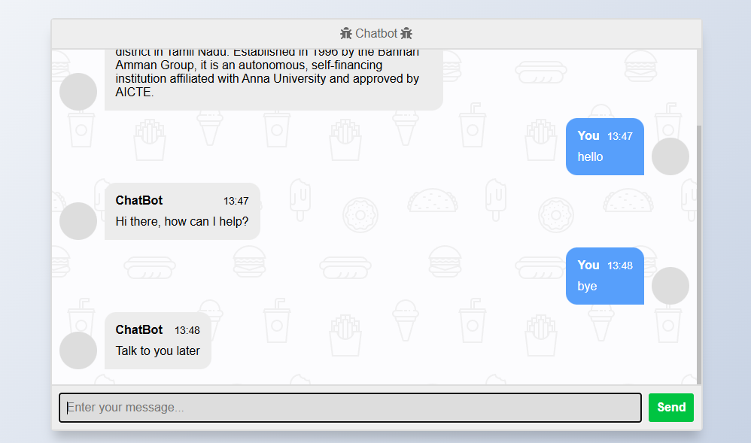
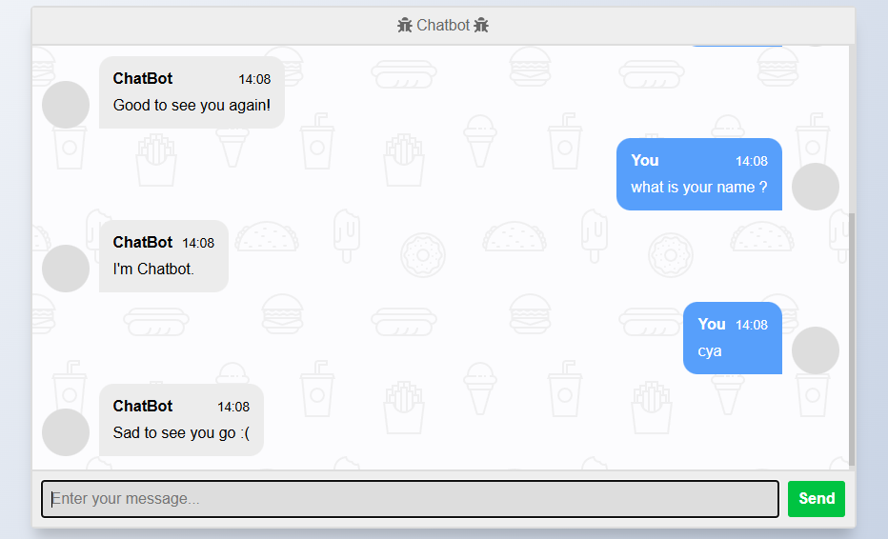
DESIGN(S) (HARDWARE / SOFTWARE ARCHITECTURE)

Slide 42
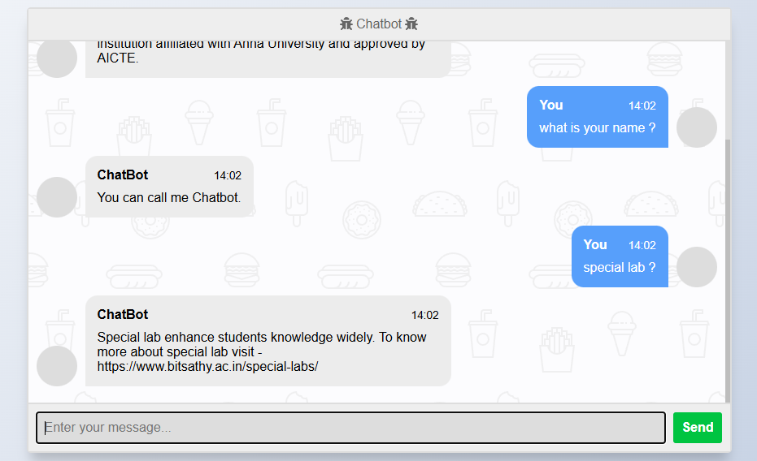
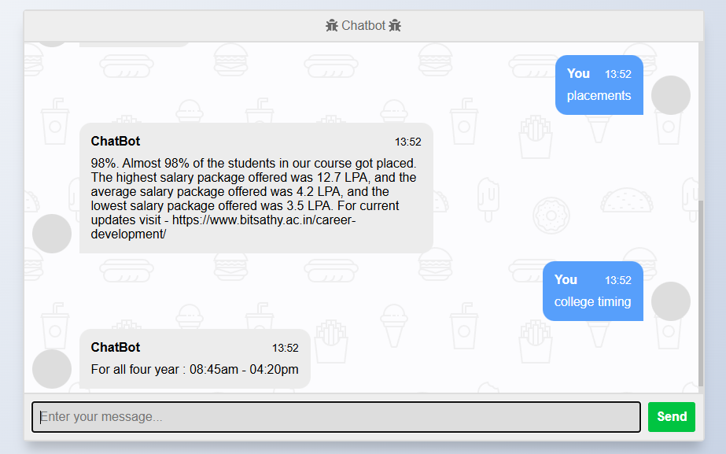
DESIGN(S) (HARDWARE / SOFTWARE ARCHITECTURE)

Slide 43
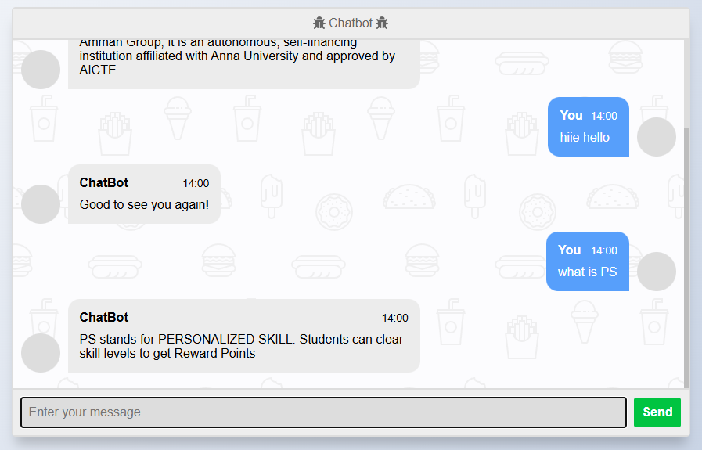
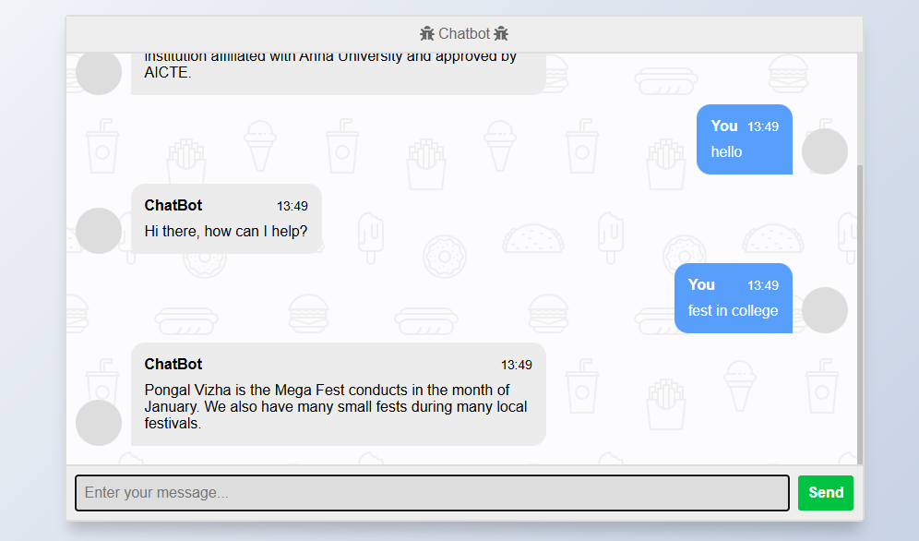
DESIGN(S) (HARDWARE / SOFTWARE ARCHITECTURE)

Slide 44
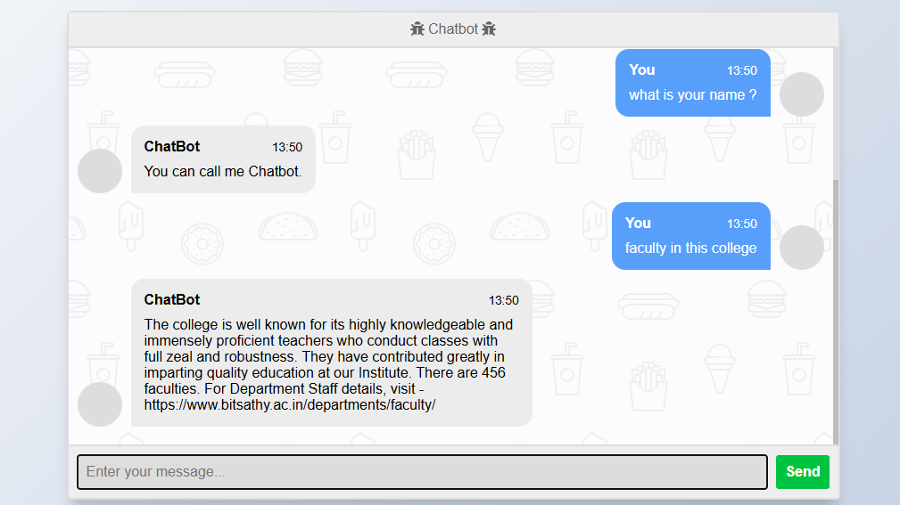
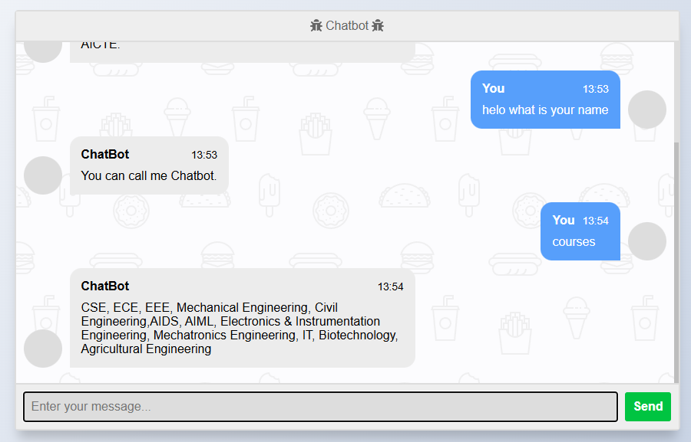
DESIGN(S) (HARDWARE / SOFTWARE ARCHITECTURE)

Slide 45
ANALYSIS OF RESULTS AND DISCUSSION
The developed chatbot system successfully answers frequently asked admission-related queries such as course details, eligibility criteria, fee structure, and important dates. It uses a rule-based or keyword-matching approach to map user input to predefined responses, providing accurate answers for well-structured questions. The system is effective in reducing the manual workload on admission staff and offers 24/7 accessibility to prospective students. The chatbot performs best within its trained domain but struggles with vague or out-of-scope inputs. Future improvements could include integrating NLP models or machine learning techniques to enhance flexibility, context handling, and response accuracy.
Overall, the project demonstrates a practical and functional solution for automating admission inquiries, with clear potential for scalability and real-world deployment.

Slide 46
CONCLUSION
This bot was built to respond to the inquiries of students and parents regarding university's admission and their specializations, with extracted information for each specialization, familiarizing students and parents with the fees structure, and the required documents that students submit for their enrollment in the university. Implementing an admission chatbot can offer numerous benefits for the College. Chatbots can provide faster and more efficient responses to common admission-related queries, reduce the workload of staff during admission times, improve the user experience for prospective students and parents, reduce parents waiting in lines for inquiry during admissions and potentially increase the number of applications submitted and enrolled students.

Slide 47
INDIVIDUAL CONTRIBUTIONS TO THE WORK
Batch Member 1 : (7376231MZ134 & PRINCIA I)
1. Installation of Required Packages - Flask, NLTK, NumPy, and scikit-learn
2. Set up a virtual environment and installed Flask, NLTK, NumPy, and scikit-learn for backend development, natural language processing, numerical computations, and machine learning tasks.
created API routes in Flask for handling user messages dynamically.
3 . Preprocessed text using tokenization, stemming(tense), and lemmatization (definition).
4. Conducted manual testing of all features to identify bugs and ensure smooth functionality.
5. Integration the Flask framework to connect the chatbot’s frontend with the backend model.
6. Configuration of Flask to load the trained model and respond to API calls efficiently and JSON-based data exchange between frontend JavaScript and Flask.

Slide 48
INDIVIDUAL CONTRIBUTIONS TO THE WORK
Batch Member 2 : (7376231CS114 & ANUSHA G )
Styling and Layout :
CSS is used to style HTML elements by adding colors, fonts, margins, padding, borders, and controlling the overall layout of a webpage.
Responsive Design :
CSS enables webpages to adapt to different screen sizes and devices using media queries and flexible layouts.
Separation of Content and Design:
CSS keeps design separate from HTML structure, making code cleaner, reusable, and easier to maintain.
Advanced Features:
CSS provides animations, transitions, flexbox, and grid systems to create interactive and modern user inter

Slide 49
INDIVIDUAL CONTRIBUTIONS TO THE WORK
Batch Member 3 : (7376232IT184 & KONDAMMAL C )
Created real-time search and filter feature that instantly displays relevant results as the user types.
Built responsive UI behavior (show/hide sections, highlight active tags) through JavaScript DOM control.
Developed core logic for adding, editing, and deleting items/snippets using pure JavaScript (DOM manipulation & event handling).
Optimized code readability and modularity by organizing functions for CRUD operations, rendering, and event binding separately.
Handled user interactions efficiently using modern ES6+ features like arrow functions, template literals, and array methods.

Slide 50
INDIVIDUAL CONTRIBUTIONS TO THE WORK
Batch Member 4 : (7376231MZ108 & GOKUL RITHIS N )
Defined Chatbot Objective: Identified the purpose of the chatbot to assist students with admission, fees, courses, and other queries.
Collected Real Questions: Gathered FAQs from the college website and through interactions with students to understand common queries.
Organized Intents: Structured collected questions into intents with unique tags representing different categories like “admission_procedure,” “fee_structure,” and “course_offerings.”
Created Patterns: For each intent, wrote multiple patterns representing different ways users might ask the same question.
Defined Responses: Paired each intent with appropriate responses the chatbot should provide to user queries.
Created sample data structures and defined how data will be stored or retrieved in the project.
27-10-2025

Slide 51
REFERENCES ( Journal Papers/ Books / Website in IEEE Format )
Journal
R. Winkler and M. Söllner, "Unleashing the Potential of Chatbots in Education: A State-of-the-Art Analysis," Academy of Management Learning & Education, vol. 19, no. 4, pp. 443–456, 2020.
Books
A. Tsvetkov, Chatbots and Conversational Agents: A Practical Guide, Springer, 2021.
Patent
S. K. Choudhury, "System and Method for Providing Educational Chatbot Assistance," U.S. Patent 10,965,112, Mar. 30, 2021
Website
R. Sharma, "AI Chatbots Transforming College Admissions:Automating Student Support," edtechmagazine.com. Available:https://edtechmagazine.com/article/ai-chatbots-college-admissions (accessed Sep. 8, 2025).

